Slide 1


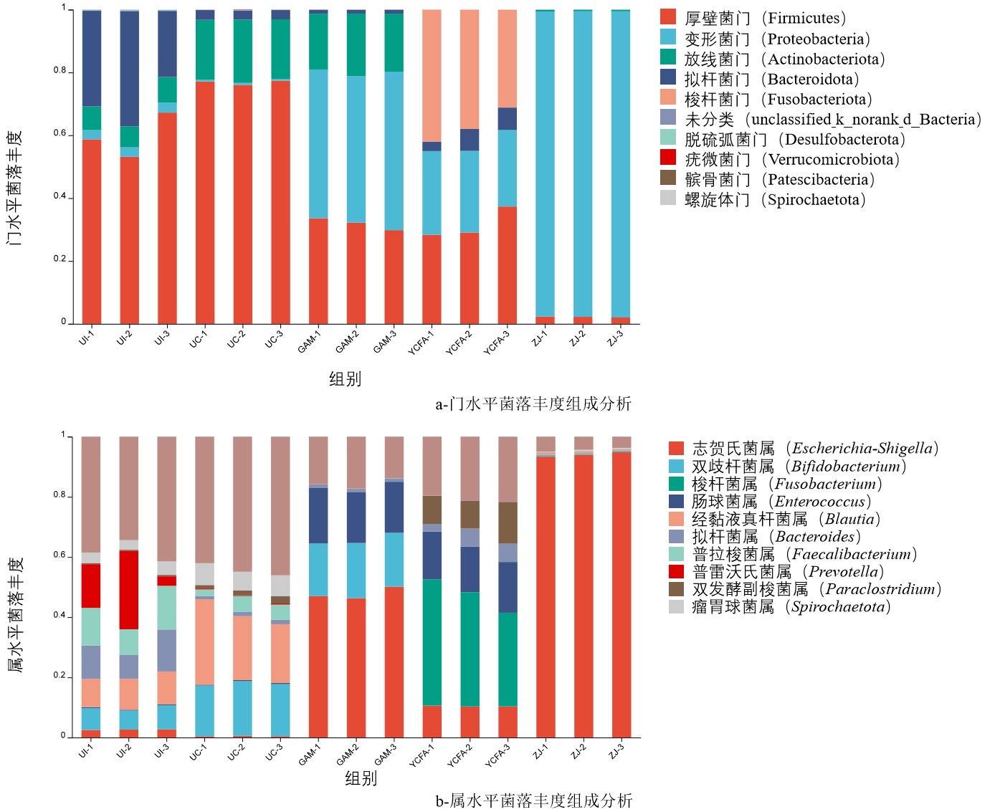
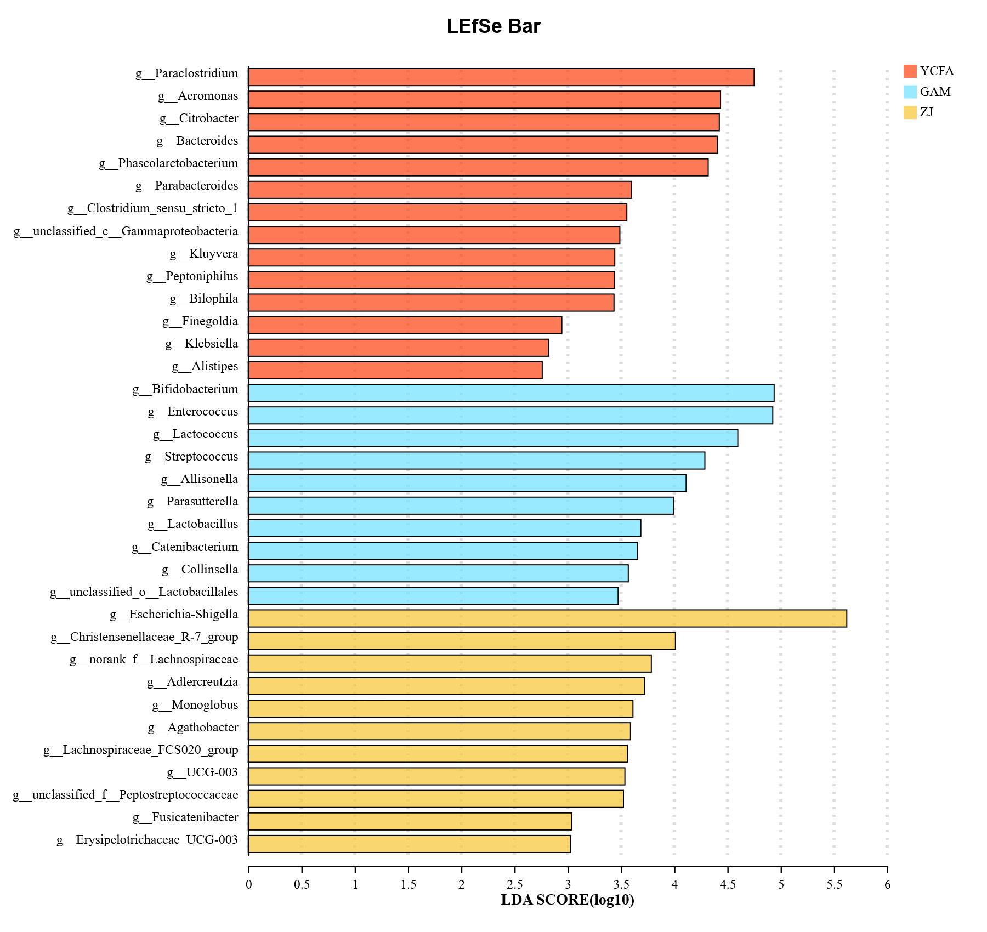
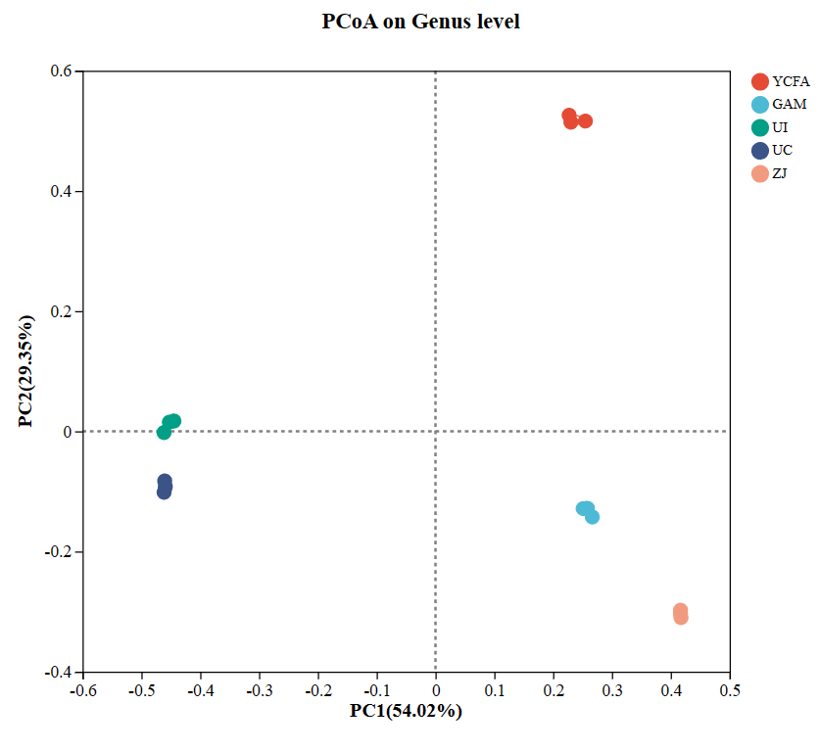
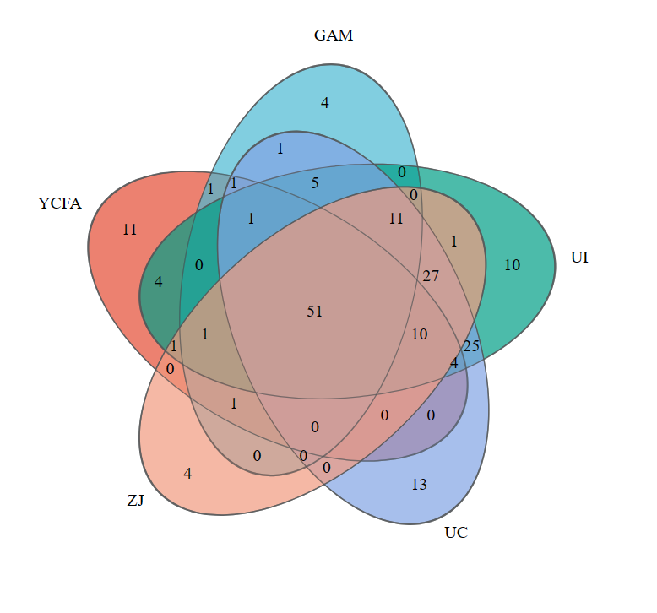
Comparative Analysis of the Effects of Different Nutrient-Rich Media
on In Vitro Cultivation of Human Gut Microbiota
Lu Jing, Xia Xuejuan, Huang Junnan, Chen Xuanyu, Zhou Lu, Dong Qingli*
School of Health Science and Engineering, University of Shanghai for Science and Technology
Shanghai, 200093, China
Background
The emergence of culturomics technology, with nutrient-rich media (RM) as a key component, has provided crucial support for investigating the mechanisms underlying the interactions between gut microbiota and the host.
Method
To investigate the effects of different RM on the in vitro cultivation of human gut microbiota, plate counting method and 16S rDNA high-throughput sequencing technology were employed to analyze the cultivation outcomes of Yeast extract-casein hydrolysate-fatty acid medium (YCFA medium), Gifu Anaerobic Medium (GAM medium), and a patented ZJ medium.
Result
1：Analysis of Total Colony Count Changes
The maximum total colony counts obtained from the three media followed this order: ZJ medium (9.88 log10 CFU/mL) > GAM medium (9.79 log10 CFU/mL) > YCFA medium (9.68 log10 CFU/mL).
Fig. 1 Variation trends of total colony counts in GAM (A), YCFA medium (B), and ZJ (C) under different solid media colony counting conditions.
2：α-Diversity Analysis
Compared with GAM and YCFA media, the microbial diversity of communities cultured in ZJ showed a significant decrease. Additionally, the bacterial diversity after in vitro cultivation was reduced compared to the uncultured gut microbiota.
3：Changes in Microbial Composition
High-throughput sequencing results revealed a reduction in bacterial diversity after in vitro cultivation, with ZJ exhibiting the most significant decline in community diversity. β-diversity analysis demonstrated that the microbial composition cultured in GAM more closely resembled that of the uncultured gut microbiota。
Fig. 2 A: Analysis of microbial composition at the phylum and genus levels; B: LDA discriminant results of the three media; C: PCoA analysis; D: Species Venn diagram.
Table 1. Impact of Different Culture Media on Microbial α-Diversity Indices
Group | Shannon | Coverage | Simpson | Ace | Chao1
UI | 3.83±0.24ª | 0.9987±0.00011^{b} | 0.06±0.02^{d} | 746.20±45.67ª | 722.00±47.60ª
UC | 3.73±0.05ª | 0.9989±0.00005^{b} | 0.06±0.01^{d} | 672.00±19.01^{b} | 654.10±19.93ª
YCFA | 2.26±0.15^{b} | 0.9996±0.00010ª | 0.18±0.03^{c} | 163.10±10.25^{c} | 156.10±10.93^{b}
GAM | 1.91±0.05^{b} | 0.9996±0.00002^{b} | 0.27±0.02^{b} | 151.20±9.19^{c} | 147.10±10.58^{b}
ZJ | 0.40±0.03^{c} | 0.9994±0.00013ª | 0.89±0.01ª | 178.60±17.84^{c} | 168.40±25.03^{b}
A
B
A
B
C
C
D
In conclusion, compared to YCFA and ZJ media, GAM is a more suitable RM for the in vitro cultivation of gut microbiota.

